Slide 1
Image Annotation Research Paper Review
Sadia Ahmed Tandra (1631474042)
Jannatul Ferdouse Onny (1631561042)
Md Sehebub Zaman Pranta (1611251042)
Tanvir Ahmed (1410982042)
Rokeya Akanda Sriti (1620165042)
CSE499A.10

Slide 2
A Quadtree Image Segmentation G.R. Márquez, Hugo Jair Escalante, Luis Sucar
The proposed method is able to efﬁciently divide the image in homogeneous segments by merging adjacent regions using border and color information.
This method is highly efficient and provides segmentations of acceptable performance used for automatic image annotation and related tasks like object recognition.
The main objective is to offer a tradeoff between efficiency and segmentation that aims at give support to automatic image annotation and content-based image retrieval (CBIR).

Slide 3
A Quadtree Image Segmentation (Cont.)
This technique follows some guidelines like:
Recursively divide the image using a quadtree approach.
Merge homogeneous and similar quadtrees’ regions based on borders and color information.
Process and discard large image regions as fast as possible
Prefer detection of large objects.
Avoid noise in result segments and provide any-time segmentation.

Slide 4
A Quadtree Image Segmentation (Cont.)
Dividing the segmentation process in ﬁve steps:
(1) Edge detection,
(2) Border processing,
(3) Color discretization,
(4) Quadtree scanning and
(5) Segmentation enhancement.
Although our formulation is intended for automatic image
annotation usage, it can be used for other tasks that require
a fast segmentation implementation.

Slide 5
How It Works
Minimum Object Size
Image
(1)Border Detection
(2)Border Selection
(3)Color
Discretization
(4)QuadTree Segmentation
Minimum quad Size
Homogeneity threshold
(5)Segmentation Enhancement
Segmentation
Result

Slide 6
Time Complexity
For each step the complexity are following:
(1) Border detection: 7×N;
(2) Border selection: 4N
(3) Color discretization: N
(4) QuadTree scanning: 2^{log}₄^{(N-1)}6N+C ; with C the number of operations required to divide a quadtree
(5) Segmentation enhancement: 2K+K²+N; with K the number of segments found.

Slide 7
The Goal Of This Experiment
To evaluate the segmentation performance of the proposed method where
First one consists of 18 heterogeneous manually selected images;
Second one consists of 100 randomly selected images from the Berkeley Segmentation Dataset
Third dataset consists of 14 images randomly selected from “Image of the Day” Wikipedia section

Slide 8
The Goal Of This Experiment (Cont.)
To evaluate the performance of an annotation method with segments generated with our segmentation technique in terms of segmentation and annotation accuracy
The annotation performance was evaluated with a dataset consisting of 500 images taken from the SAIAPR TC-12 , which is a benchmark of manually segmented and annotated images.

Slide 9
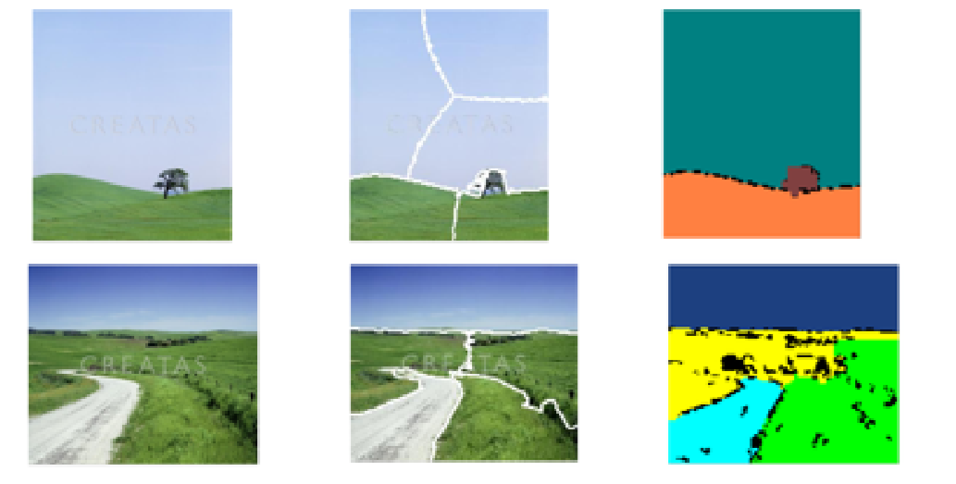
The Look Of Quadtree Image Segmentation

Slide 10
Result
This method is more accurate than those generated with normalized cuts. It is common for normalized cut stop partition regions that belong to the same object in more than a single region
But here in this method, it correctly identifies homogeneous segments. Here noted that was stated above, segmentation is a highly subjective process, hence evaluating the quality of segmentations produced with different methods is a subjective task as well.

Slide 11
Conclusion
This is a simple and efficient method for image segmentation, which resulted very helpful for image annotation, as evidenced by experimental results. This is specially true for images with big objects and simple textures.
The any time segmentation feature of our proposal in combination with its order of complexity makes it attractive to be used in time restricted environments

Slide 12
Image Annotation Using SVM Claudio Cusano, Gianluigi Ciocca, Raimondo Schettini
Automatic image annotation is useful in image processing algorithms, in intelligent scanners, digital cameras, photocopiers, and printers.
In this paper they propose a tool capable of automatically annotating digital photographs, by assigning the regions to seven different classes: sky, skin, vegetation, snow, water, ground, and buildings.
The annotation is performed by a classification system based on a multi-class Support Vector Machine.

Slide 13
Support Vectors Machines
Support Vectors Machines was chosen because they do not require any distributional assumption about the features, and have provided good generalization accuracy in other imaging applications, even in the case of feature spaces of large dimensions.
The SVM methodology comes form the application of statistical learning theory to separating hyperplanes for binary classification problems. The central idea of SVM is to adjust a discriminating function so that it makes optimal use of the separability information of boundary cases.

Slide 14
Multi-class SVM
Although SVMs are mainly designed for the discrimination of two classes, they can be adapted to multi-class problems.
A multi-class SVM classifier can be obtained by training several classifiers and combining their results.
There are several strategies for combining SVMs; Two common methods are “one per class” and “pairwise coupling”

Slide 15
Data Selection And Description
They applied different SVM-based classification strategies and feature sets to semantically classify regions in digital photographs. Seven classes were considered.

Slide 16
Experimental Results
For classification, they used a multi-class SVM, constructed according to “one per class” strategy. To train each of the seven SVM, they used the 1500 tiles of the related class, taken from the training set, and a random selection of 1500 tiles of the other classes.
Each SVM was thus trained to discriminate between one class and the others.

Slide 19
Conclusions
Although the accuracy of the tool is quite satisfactory, they plan to further refine the whole strategy.
The misclassified pixels are generally on the boundary between two classes, or inside very dark areas, where the information about color and texture is insufficient.
The types of the error made by the tool suggests that it cannot be used as a segmentation tool: a more specific segmentation strategy would be needed for this purpose.

Slide 20
References
Márquez, G.R. & Escalante, Hugo Jair & Sucar, Luis. (2011). Simplified quadtree image segmentation for image annotation. CEUR Workshop Proceedings. 719. 24-34.
Cusano, Claudio & Ab, Gianluigi & Ciocca, Gianluigi & Schettini, Raimondo. (2003). Image annotation using SVM. Internet Imaging V. 5304. 10.1117/12.526746.

Slide 21
Github Repository Link
https://github.com/sehab1611251/CSE-499

Slide 22
Thank You

